Slide 1
Educating The Next Generation
©2019 Institute for Preparing Heirs │ All Rights Reserved

Slide 2
Educating The Next Generation
Legacy & Impact Are Not Optional
Lisa D. Snyder
Legacy Strategist & Faculty
INSTITUTE for PREPARING HEIRS®
626.389.8664

Slide 3
EDUCATING THE NEXT GENERATION
What is Your Legacy?
Notes:
LOOK AT THIS SIMPLE MISSION STATEMENT…
THE WORDS “TRUSTED FAMILY ADVISOR” ARE THE GOAL….AND EMBRACING THE ENTIRE FAMILY AS YOUR CLIENT IS WHERE IT BEGINS
TODAY WE WILL INTRODUCE YOU TO THE TOOLS, GIVE THE TOOLS TO YOU, AND TEACH YOU HOW TO USE THE TOOLS WITH THE CLIENT FAMILY

Slide 4
EDUCATING THE NEXT GENERATION
The Largest Wealth Transfer in History
$68 trillion
45 million U.S. households over 25 years
Cerculli Associates, 2018
Notes:
BECAUSE THE SPECIFICS OF THE GREAT WEALTH TRANSFER ARE STAGGERING…
THAT’S $1 TRILLION EACH YEAR!
…AND WHILE THAT IS HAPPENING, WOMEN ARE BEING MOVED INTO POSITION TO CONTROL 70% OF THE WEALTH BY 2030
SIMPLY BECAUSE THEY ARE YOUNGER THAN THEIR SPOUSES
BECAUSE THEY ARE HEALTHIER THAN MEN
BECAUSE THEY LIVE LONGER
…CAN YOU SEE THE OPPORTUNITY FOR THE “TRUSTED FAMILY ADVISOR”?

Slide 5
EDUCATING THE NEXT GENERATION
Wealth Transfer Outcomes
30% survive the second generation.” − The Williams Group
10% survive the third generation.” − The Williams Group
Notes:
THOSE WORKING WITH WEALTHY FAMILIES FOR A GENERATION OR MORE ALL SHARE THE SAME OBSERVATION: MANY, IN FACT MOST, ESTATES FAIL FOLLOWING THE SUCCESSFUL TRANSITION OF THEIR WEALTH TO THE NEXT GENERATION. THIS IS THE FIRST PROBLEM WE WILL BE ADDRESSING – WHY DOES THIS HAPPEN?
BUT THIS IS NOT THE ONLY ISSUE AT HAND . . .

Slide 6
EDUCATING THE NEXT GENERATION
Why families don’t continue to prosper and thrive
Lack of trust and communication

Slide 7
EDUCATING THE NEXT GENERATION
EDUCATING THE NEXT GENERATION
The 3 Assessments of Trust
Reliability
Sincerity
Competence

Slide 8
EDUCATING THE NEXT GENERATION
EDUCATING THE NEXT GENERATION
Why families don’t continue to prosper and thrive
Lack of trust and communication
Beneficiaries are unprepared to receive wealth and to use it productively

Slide 9
SAMPLE FAMILY MEETING AGENDA
9:30 a.m. | Arrivals
10:00 a.m. | Welcome to The Family Gathering
10:15 a.m. | Beneficiary Roles and Responsibilities
11:30 a.m. | Lunch – Oak Grill
12:30 p.m. | Who Gets Grandma’s Yellow Pie Plate
1:00 p.m. | Defining Our Family Wealth and Shared Values
1:45 p.m. | Our Family Philanthropy
2:45 p.m. | Takeaways and Wrap Up
Notes:
OVER 100 YEARS AGO, CHARLES DARWIN SAW THIS FACTOR…
AND EITHER WE ADAPT AS ADVISORS TO OUR CLIENT (FAMILIES) OR, VERY SIMPLY, WE WILL NOT SURVIVE
AND TODAY WE WILL GIVE YOU THE FACTS TO PROVE THAT POINT

Slide 10
EDUCATING THE NEXT GENERATION
Why families don’t continue to prosper and thrive
Lack of trust and communication
Beneficiaries are unprepared to receive wealth and to use it productively
No family wealth mission statement

Slide 11
EDUCATING THE NEXT GENERATION
OUR DEFINITION
Family Wealth Mission Statement
Your family wealth mission statement serves as a guidepost for your family and your trusted advisors – today and for generations to come.
It articulates your core family values and the priorities for the use of your family wealth.
Notes:
KEY WORDS:
SHORT
EASILY REMEMBERED
DECLARATION
CREATED AND HONORED BY THE WHOLE FAMILY
IT IS NOT DAD’S MISSION, OR MOM’S MISSION
IT IS THE CONSENSUS MISSION OF THE WHOLE FAMILY

Slide 12
EDUCATING THE NEXT GENERATION

Slide 13
EDUCATING THE NEXT GENERATION
Moving Conversations from Money Matters to
Family Matters
Notes:
SO, FOR PART ONE, LET’S SIMPLY SET THE STAGE FOR YOU TO UNDERSTAND WHAT YOUR CLIENTS ARE FACING…
WHAT THE MARKET AND CLIENT STUDIES SAY ARE FACING CLIENTS…
AND WHAT THIS PHRASE “THE GREAT WEALTH TRANSFER” MEANS….

Slide 14
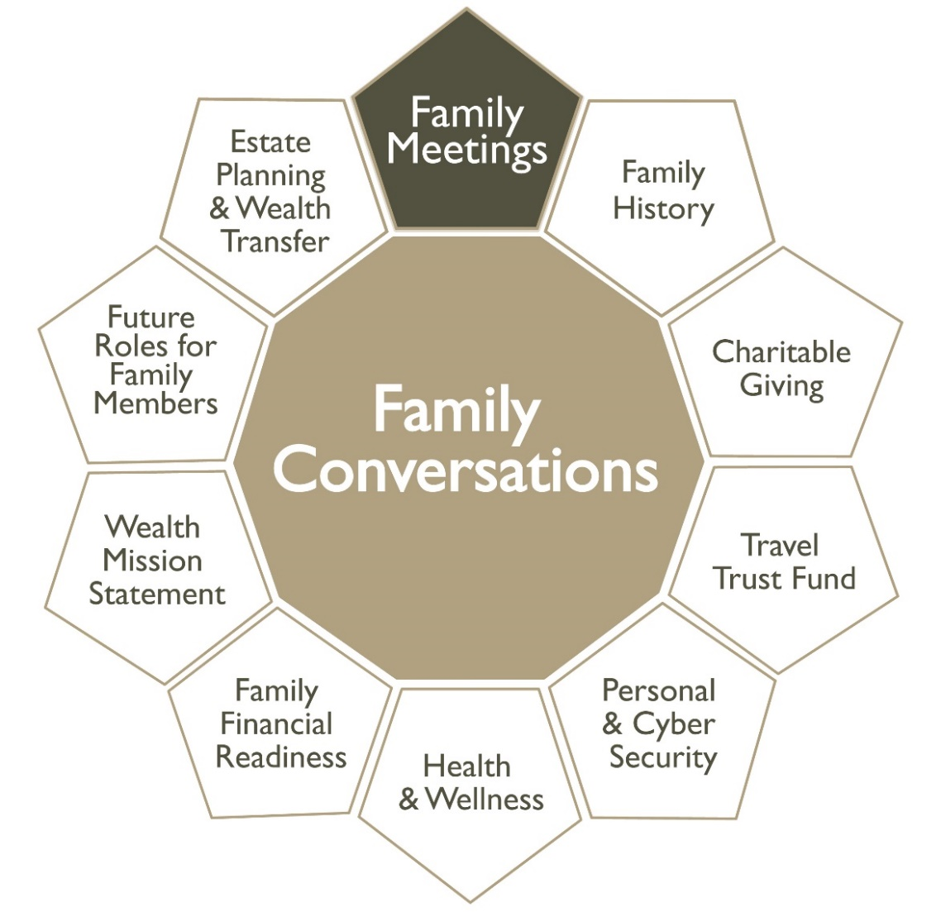
EDUCATING THE NEXT GENERATION
Other Conversations Families Can Have
Notes:
TAKEAWAYS
TOOLS
TRADING IDEAS ON HOW TO PUT IT IN PRACTICE

Slide 15
“I’ve learned that you shouldn’t go through life with a catcher’s mitt on both hands;
You need to be able to throw something back.”
– Maya Angelou

Slide 16
EDUCATING THE NEXT GENERATION
2018 U.S. Trust Study of
High Net Worth Philanthropy
Desired Allocation for Distribution of Wealth:
86% Family
14% Charity
0% IRS
Notes:
THE OPPORTUNITIES FOR ASDVISORS HAVE NEVER BEEN GREATER, ESPECIALLY DURING THIS TIME OF “THE GREAT WEALTH TRANSFER”
TO DIFFERENTIATE YOUR PRACTICE FROM THAT OF YOUR COMPETITORS
TO BUILD LONG-LASTING RELATIONSHIPS THAT RETAIN THE CLIENT THRU GENERATIONAL TRANSFERS
TO ATTRACT NEW CLIENTS DUE TO YOUR UNIQUE PERSPECTIVE OF SERVING THE ENTIRE FAMILY
AND TO BUILD YOUR NETWORK OF REFERRAL SOURCES THROUGH OFFERING NON-COMPETITIVE INTERGENERATIONAL KNOWLEDGE TO LAWYERS, ACCOUNTANTS, TRUST COMPANIES, INSURANCE AGENCIES, ETC,
THE INSTITUTE FOR PREPARING HEIRS IS HERE TO TRAIN YOU, AND TO DO RESEARCH….IT DOES NOT OFFER TAX, INTESTMENT, ACCOUNTING OR LEGAL ASDVICE

Slide 17
EDUCATING THE NEXT GENERATION
OUR DEFINITION
Vehicles of Generosity
Public charities
Private (non-operating) foundations
Private (operating) foundations
Donor advised funds
Notes:
YOU EACH HAVE YOUR “PRIME EXAMPLES” OF CASE STUDIES…
PEOPLE AND SITUATIONS YOU KNOW, OR WANT TO GET IN RELATIONSHIP WITH..
OBVIOUS CLIENT FAMILIES
PROSPECTIVE FAMILIES WHO ARE SEEKING SOMEONE LIKE YOU WHO CAN HELP THEM “THRIVE AND PROSPER ACROSS GENERATIONS”
AND “INFLUENCERS SUCH AS ACCOUNTANTS, LAWYERS, TRUSTEES, AND OTHER PROFESSIONAL ADVISORS WHO HAVE CLIENTS THAT WOULD BE GRATEFUL FOR AN INTRODUCTION TO YOUR TOOLS…YOUR SKILLS
…NOT AS COMPETITORS TO THEIR PROFESSIONAL ADVISORS, BUT AS RESOURCES, COLLEAGUES, SERVING THE SAME CLIENT FAMILY GOALS.

Slide 18
EDUCATING THE NEXT GENERATION
2018 U.S. Trust Study of
High Net Worth Philanthropy
48% of Donors have a Giving Budget
49% of Donors have a Giving Plan
Notes:
THE OPPORTUNITIES FOR ASDVISORS HAVE NEVER BEEN GREATER, ESPECIALLY DURING THIS TIME OF “THE GREAT WEALTH TRANSFER”
TO DIFFERENTIATE YOUR PRACTICE FROM THAT OF YOUR COMPETITORS
TO BUILD LONG-LASTING RELATIONSHIPS THAT RETAIN THE CLIENT THRU GENERATIONAL TRANSFERS
TO ATTRACT NEW CLIENTS DUE TO YOUR UNIQUE PERSPECTIVE OF SERVING THE ENTIRE FAMILY
AND TO BUILD YOUR NETWORK OF REFERRAL SOURCES THROUGH OFFERING NON-COMPETITIVE INTERGENERATIONAL KNOWLEDGE TO LAWYERS, ACCOUNTANTS, TRUST COMPANIES, INSURANCE AGENCIES, ETC,
THE INSTITUTE FOR PREPARING HEIRS IS HERE TO TRAIN YOU, AND TO DO RESEARCH….IT DOES NOT OFFER TAX, INTESTMENT, ACCOUNTING OR LEGAL ASDVICE

Slide 19
EDUCATING THE NEXT GENERATION
Create Your Charitable Giving Strategy
Why do you give?
What do you want to achieve?
What is your capacity to give?
What are your interests (values)?
What is your access to organizations that interest you?
How do you wish to be acknowledged?
What accountability do you want from the organization?
How will you measure progress?
Who will join you?

Slide 20
EDUCATING THE NEXT GENERATION
2018 U.S. Trust Study of
High Net Worth Philanthropy
Giving as a family:
3 in 10 volunteer with a family member
6 in 10 give to set an example for future generations
1 in 5 discuss charitable giving across generations

Slide 21
EDUCATING THE NEXT GENERATION
Build a Culture of Gratitude Within Your Family
Scientific research has demonstrated that a practice of gratitude not only increases our happiness and well-being by 25% on average, but also allows us to avoid the negative effects of entitlement & affluenza.
GRATITIUDE + GENEROSITY = HAPPINESS, HEALTH & LONGEVITY
– Dr. Robert Emmons, “Thanks! How The New Science of Gratitude Can Make You Happier”

Slide 22
EDUCATING THE NEXT GENERATION
The Way Forward
Plans should mirror goals, values and aspirations
Family communication is essential to a successful transition
Define the overall purpose of family wealth and the priorities for its use
Have a giving plan and a giving budget
Start engaging everyone in the family in giving

Slide 23
Legacy and impact are not optional.
What is optional is your intentionality
in planning for them.

Slide 24
Educating The Next Generation
Legacy & Impact Are Not Optional
Lisa D. Snyder
Legacy Strategist & Faculty
INSTITUTE for PREPARING HEIRS®
626.389.8664

